Slide 1




HOW TO CONDUCT AN EVALUATION FOR BENEFITS REALISATION IN THE NHS
An Introduction to Evaluation Principles and Methods for Digital Projects and Programmes
Nadia Kuftinoff
Digital Transformation Lead, BOB ICB

Slide 2
PLEASE NOTE
This presentation is to support upskilling of service evaluation, e.g. the ‘as is’ or the impact of a change (implementation of a new product, process or service).
It does not detail how to conduct health economic studies (but you can find guidance here!)
It does not detail how to conduct research - we evaluate defined things with defined cohorts of participants within BOB and for BOB ICB/its stakeholders. If you have a feeling something might be research, you can check!

Slide 3


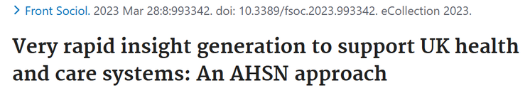

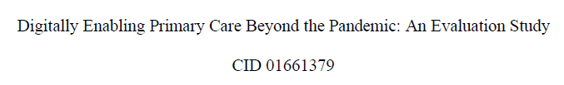
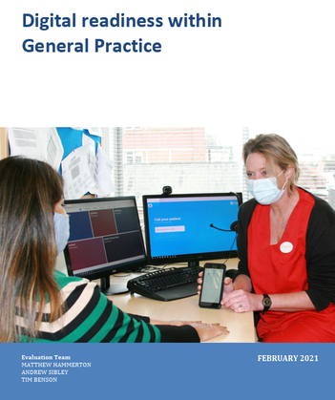


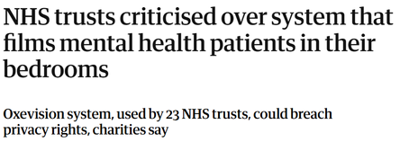

ABOUT ME
National roll-out and evaluation of mobile ECG device: implementation, evaluation interviewee
Digital Readiness in General Practice: evaluation support
Telemedicine for care homes, a strategic implementation guide: contributor
Covid-19 rapid insight evaluations (various): focus group support, thematic analysis
MSc evaluation study assessing contributing factors to digital innovation adoption in primary care in the wake of the pandemic: author
Impact on mental health service delivery of AI chatbot: lead evaluator
Remote monitoring on mental health inpatient wards: lead evaluator
Impact of NHS Digital Academy: interviewee
Interviewee in various other publications for studies

Slide 4
CONTENTS
Why are Evaluations Important?
Start with a Logic Model
Determine your data
Quantitative Data Collection: Sources
Qualitative Data Collection: Methods
Thematic Analysis
Presenting your Findings
Roadmap
Resources
Further Training
Evaluation Services

Slide 5
WHY ARE EVALUATIONS IMPORTANT?
Develop a deeper understanding of barriers and challenges, and what was done to overcome them (or what wasn’t)
Identify lessons learned about the project management and implementation processes
Discover positive outcomes you couldn’t anticipate, some of which may be more impactful than the goal in scope
Identify if an innovation (product, process or service) achieved its intended goals, e.g. time saved, money saved
Manage benefit expectations - sometimes it takes ages!

Slide 6
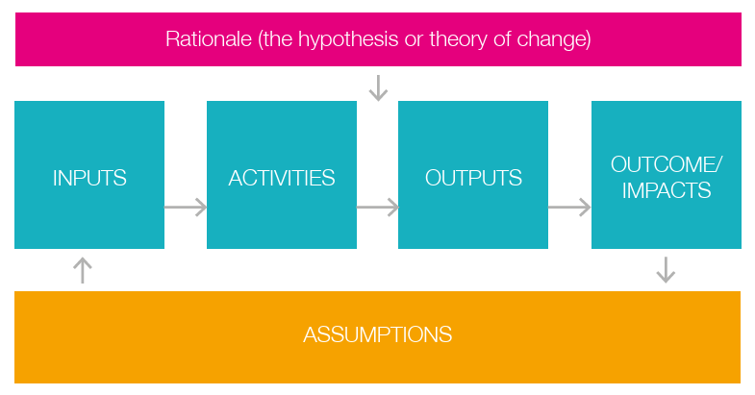
START WITH A LOGIC MODEL
A logic model is a graphic display or map of the relationship between a programme’s resources, activities and intended results, which also identifies the programme’s underlying theory and assumptions

Slide 7
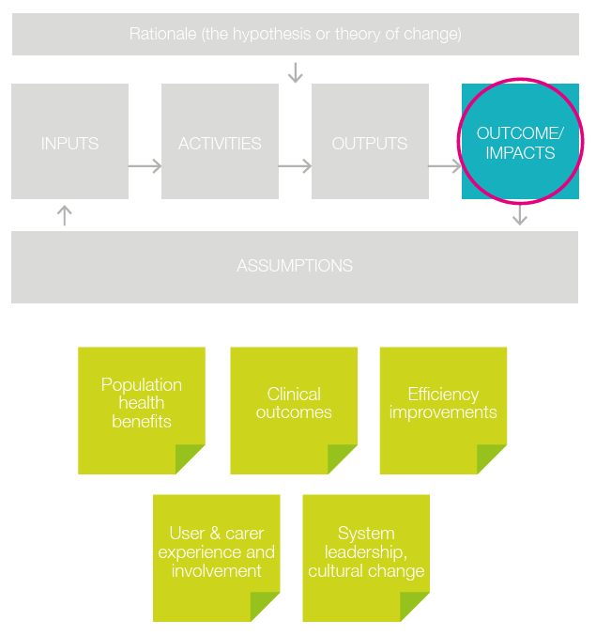
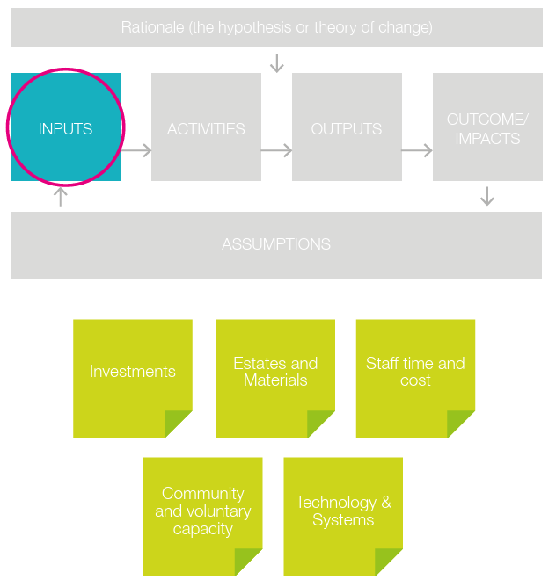

Slide 8
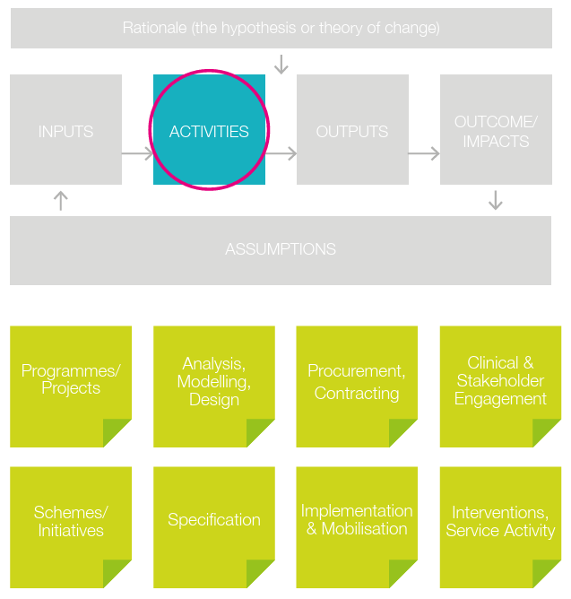
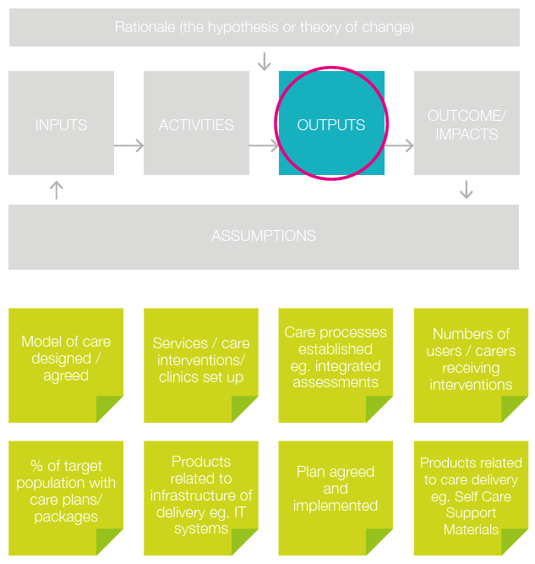

Slide 9
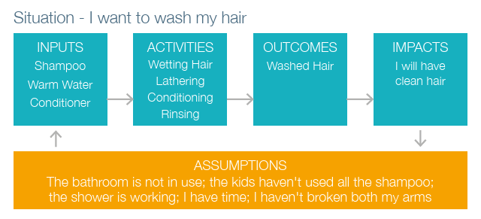

Slide 10
DETERMINE YOUR DATA
There are two different types of data and they’re basically Numbers or Words:
Quantitative data, which is numerical
Qualitative data, which represents information and concepts that aren’t numerical
I would always assume you need both - unless you can say with total confidence that only one or the other will suffice

Slide 11
Examples of quantitative data could include:
Admissions into hospital
Time on waiting lists
Demand and capacity
Improvement in time saved due to adoption of an AI chatbot tool
Responses to a survey

Slide 12
Qualitative data explores:
Thoughts, feelings, attitudes and behaviours
Contributing factors to success or failure
‘Obvious’ answers to how or why
Unexpected answers to how or why

Slide 13
Where quant and qual can work together!
Admissions into hospital
Another A&E was closed, there was a big accident on the motorway, the time of year
Time on waiting lists
Issue with referrals, staff shortages, improved processes
Demand and capacity
Tasks not being recorded correctly, new telephony system took some time to get used to
Improvement in time saved due to adoption of an AI chatbot tool
Other digital tools also helped, team very pro innovation
Responses to a survey
Why they gave those answers, what was their situation

Slide 14
QUANTITATIVE DATA COLLECTION: SOURCES
National datasets, data requests, dashboards
BOB/Frimley ICB or SCW CSU analytics teams
Research (papers, journals)
NHS National Data Platform (controversially)
Local authority
System Insights
Primary Care Support England
You!
Loads of other places, Google is your friend

Slide 15
QUALITATIVE DATA COLLECTION: METHODS
Interviews and Focus Groups
Structured
Essentially a verbal questionnaire
Semi-structured
Room for clarification and elaboration
Unstructured
Anything goes!

Slide 16
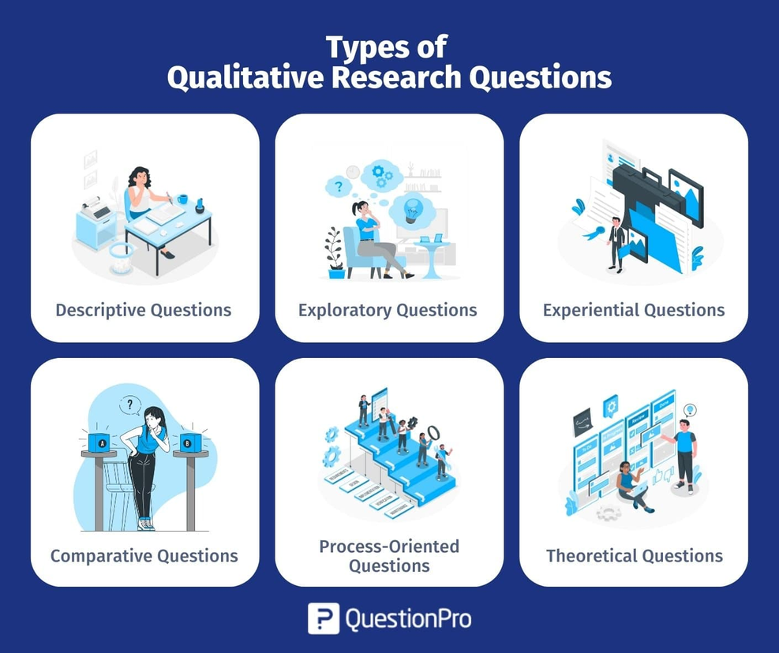
Types of question
What is your experience of living with a long term condition?
What are the factors influencing digital solution adoption?
How do PCNs with no digital transformation lead handle these projects?
How does X INT deal with a problem compared with Y INT?
What does this team do to achieve X result?
What are the factors contributing to the adoption of X digital product and the improvement of Y outcome?

Slide 17
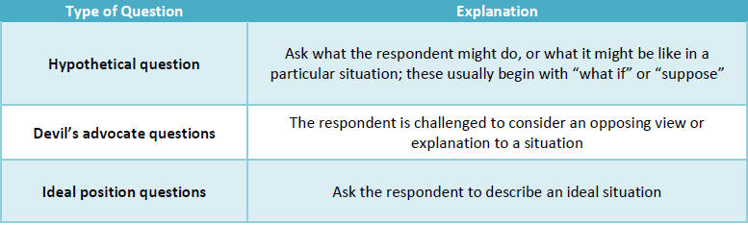

Slide 18
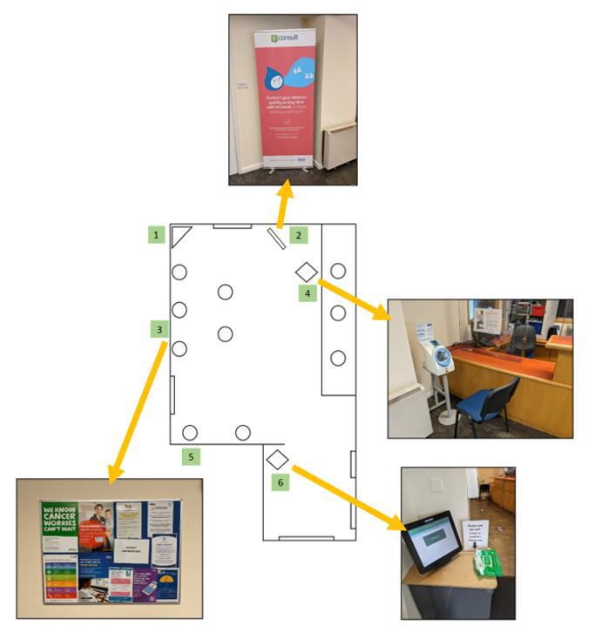
Observation/Contextual Inquiry
Go to the place and see all the things
Talk to people or just observe?
How long will you spend there?
Are you collecting data while you’re there e.g. how long it takes to complete a task?
Be mindful of the impact your presence has
You may also be able to retrieve artefacts - items that provide further insight for analysis

Slide 19
Think Aloud Study/Usability Testing
Settings tasks using a digital product and observing users as they complete them
Typically seen more often in product development
Can present findings that challenge supplier claims in terms of user experience
Can highlight barriers or challenges for different audiences e.g. workforce vs. patients, clinicians vs. non-clinicians

Slide 20
Document Review
Strategy
Policy
Reports
Articles

Slide 21
THEMATIC ANALYSIS
As the title suggests, this is all about themes that occur in your data collection.
You may have noticed themes emerge as your project took place which contributed to its successes or challenges
Your qualitative data will also have subthemes which, when tallied up, can tell you what was impactful in your project

Slide 22
For your thematic analysis, what you need to do is:
have a few main themes in mind
Go through your data to find subthemes
This gives you numerical values!
Count how many times a subtheme occurs
Count how many subthemes a theme has
The themes and subthemes with the highest number are the things that have had significant impact

Slide 23
Subtheme!
Subtheme!
Subtheme!
THEME!
THEME!
Subtheme!
Subtheme!
Subtheme!
Subtheme!
THEME!
Subtheme!
Subtheme!

Slide 24
Example 1: Digital innovation adoption in General Practice during the pandemic
I derived my themes from a literature review, but was already pretty familiar with them because of my projects.

Slide 25
THEME!
THEME!
THEME!

Slide 26
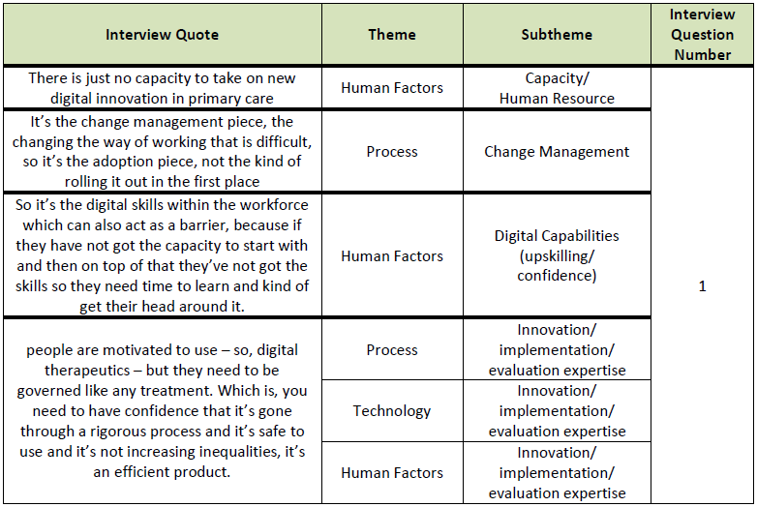
I then looked at the responses to my interview questions and decided on subthemes.
I then matched the subthemes to my themes.

Slide 27
Subtheme!
Subtheme!
THEME!
THEME!
Subtheme!
Subtheme!
Subtheme!
Subtheme!
THEME!
Subtheme!

Slide 28
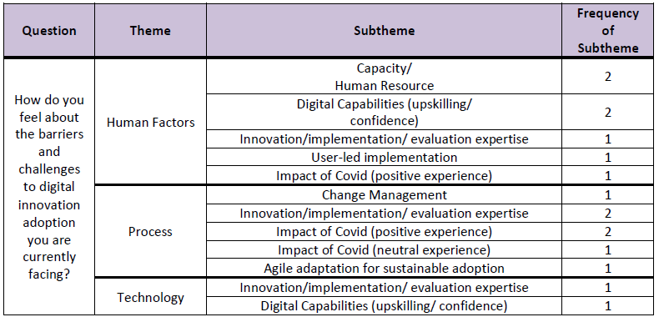
You can then start to track how many times a subtheme occurred in a response to a question...

Slide 29
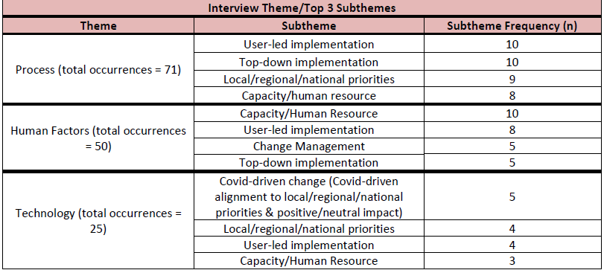
...and from there see the most influential theme and its subthemes in the thing you’re evaluating! These are your ‘crucial factors’

Slide 30
Subtheme!
Subtheme!
THEME!
THEME!
Subtheme!
Subtheme!
Subtheme!
Subtheme!
THEME!
Subtheme!

Slide 31
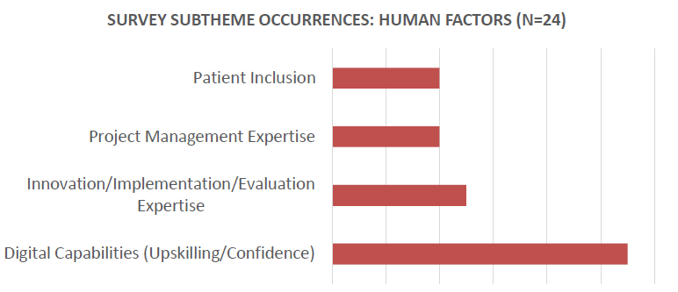
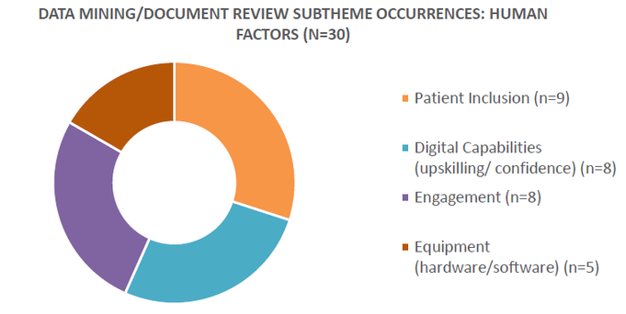
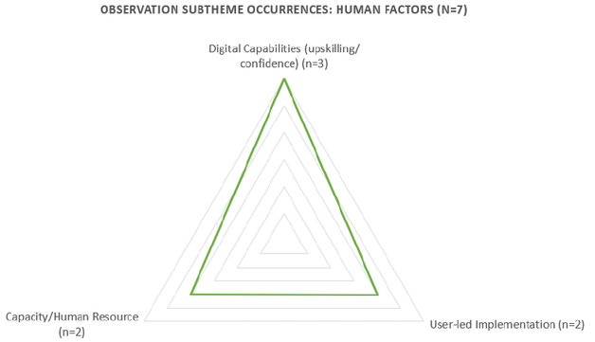
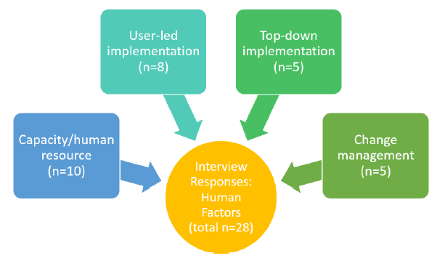
You then triangulate your data by going through this process for each of your datasets.
Here are the results of subtheme occurrences for my main theme of Human Factors across all my data:

Slide 32
Subtheme!
Subtheme!
Subtheme!
THEME!
THEME!
Subtheme!
Subtheme!
Subtheme!
Subtheme!
THEME!
Subtheme!
Subtheme!

Slide 33
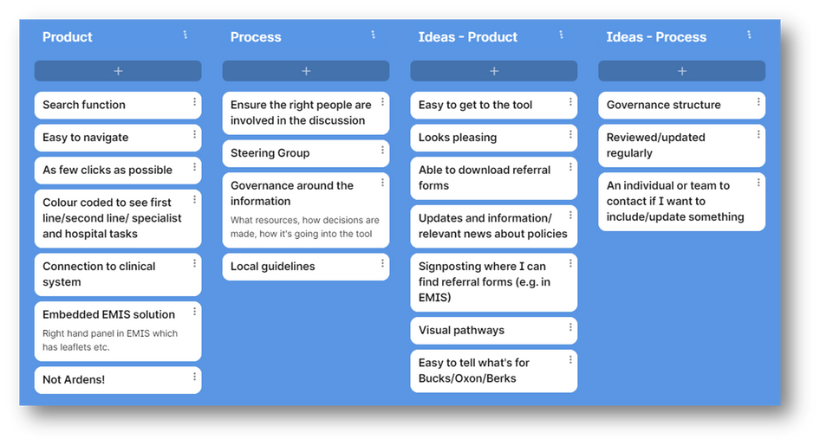
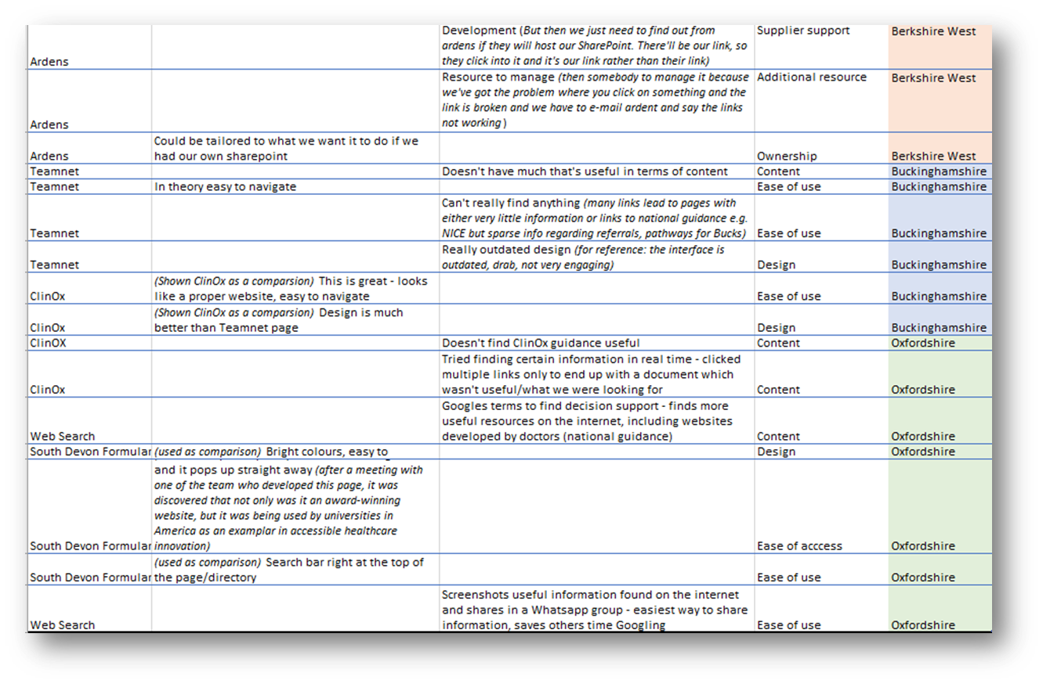
Example 2: User requirements for website re-procurement

Slide 34
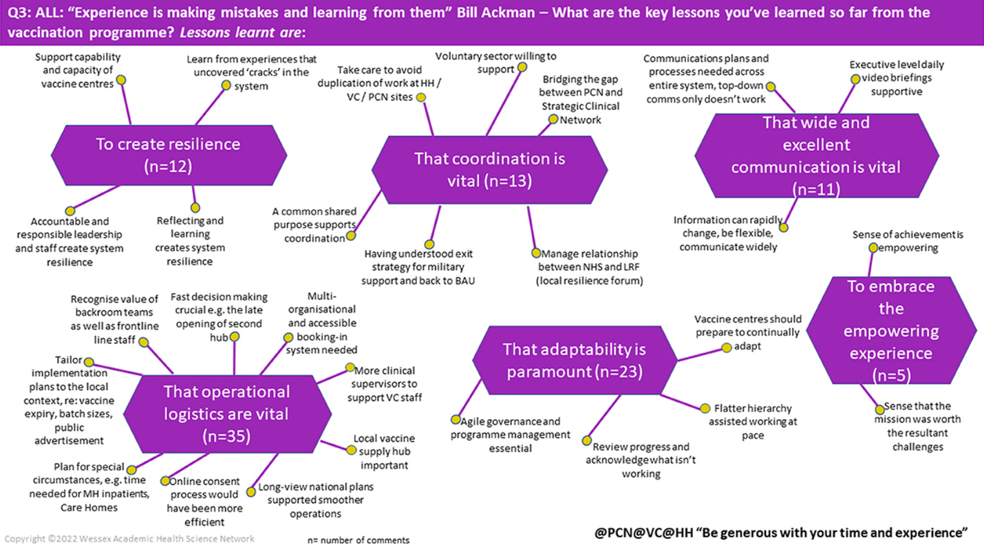
Why not run a rapid insights workshop?
Focus group with lots of facilitators to capture themes and tally up subthemes in real time!

Slide 35
PRESENTING YOUR FINDINGS
You may need to report on your findings in a report, to a Board or as a presentation. Graphs are great but what’s really important is the narrative - what does the data tell us?

Slide 36
Helpful prompts for quantitative data
What are the key statistical trends or patterns in this dataset?
What are the outliers or anomalies in the data?
Are the results expected or unexpected?
What can be perceived as positive/negative?
What do the results tell us in terms of the overall project objective?

Slide 37
Helpful prompts for qualitative data
What were the most prominent themes and subthemes in the data? (the ‘crucial factors’)
What do the crucial factors tell us in terms of the overall project objective?
What is surprising or unsurprising?
Were there challenges or successes? What were they?
Are there out of scope discoveries you feel are important to tell people about?

Slide 38
Don’t forget...
Benefits realisation isn’t always going to happen straight away - you are allowed to say if more time is required to realise benefits (it might be that a longitudinal study might be required)
Sometimes unexpected benefits happen! Let people know about them
Sometimes the benefits people want to see aren’t the ones they get - explain why this is the case
You can make recommendations not just about the project but about the evaluation! Need more time? More resources? More data? Tell people about that and explain why
Essentially you are stating if benefits have been realised (if your OUTCOMES in the logic model have been met), WHY or WHY NOT and HOW THE DATA SHOWS THIS.

Slide 39

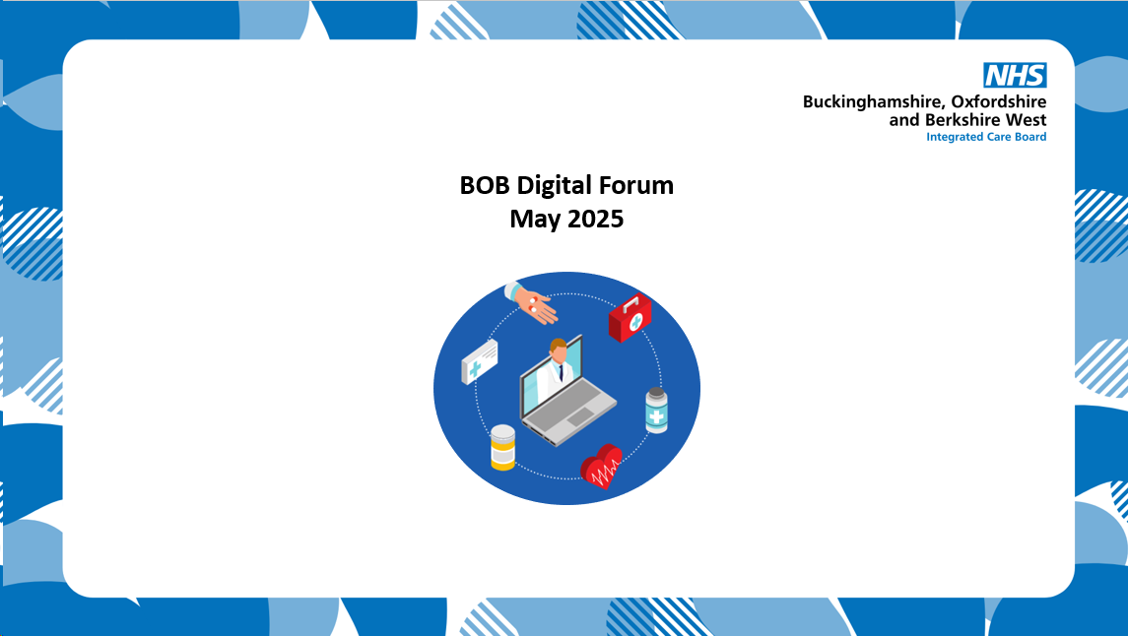
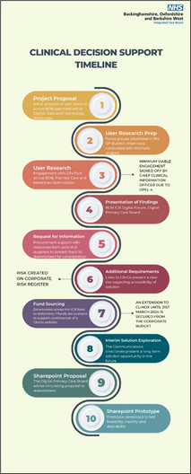
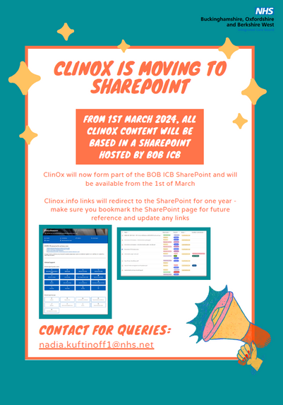
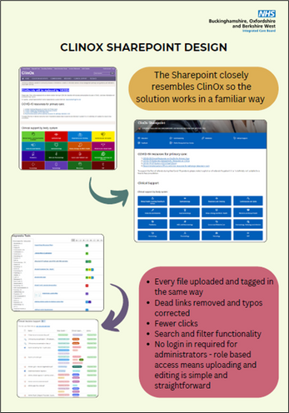

Your work deserves to be bright, bold and beautiful!
To complement your official reports, consider creating some engaging resources to go with it – these can entice people to read your work and promote what you’ve done in an accessible way. Canva.com is really easy to use and includes a free trail of its Pro version, unlocking literally thousands of templates and graphics – as well as Frutiger, the NHS font

Slide 40
ROADMAP
Write your Logic Model
Determine your data
Collect your data
Thematic Analysis
Present your findings
Some handy checklists and guides are available in the Resources slide :)

Slide 41
RESOURCES
Evaluating Digital Health Products Guidance
Logic Model Guide
Qualitative Research Questions
Focus Group Guidance
Observation/Contextual Inquiry Guidance
Think Aloud Study Guidance
Usability Testing Guidance
How to run a Rapid Insights Workshop
Evaluation Checklist
Real World Evaluation Guide

Slide 42
FURTHER TRAINING
Social Research Association
UK Evaluation Society
National Centre for Social Research
ARC West Training Courses

Slide 43
EVALUATION SERVICES
NIHR ARC - Oxford and Thames Valley
Health Innovation Network Wessex
Health Innovation Network South London
Health Innovation Network West of England
SCW CSU

Slide 44

THE END!!!

